Slide 1


A
Project Report
Submitted in the partial fulfillment for the award of
Master of Computer Application
Submitted to
DR. A.P.J. ABDUL KALAM TECHNICAL UNIVERSITY LUCKNOW (UP) INDIA
Submitted by
Gaurav Panwar
(2000290140047)
Harshit Tyagi (2000290140050)
Piyush Chaudhary (2000290140085)
Under the Guidance of
Prof. SD Mishra
DEPARTMENT OF Master of Computer Application
KIET Group of Institution

Slide 2
KIET Group of Institution
CANDIDATE DECLARATION
I hereby declare that the work, which is being presented in the project, towards the partial fulfillment of the requirement for the award of the degree of Master of Computer Application,at KIET Group of Institution, Ghaziabad (India) is an authentic record of my own work carried out during the period from January 2022 to March 2022, under the guidance of Mr. SD Mishra, Department of Master of Computer Application, KIET Group of Institution ,Ghaziabad.
I have not submitted the matter embodied in this project for the award of any other degree or diploma.
Gaurav Panwar (2000290140047)
Harshit Tyagi (2000290140050)
Piyush Chaudhary (2000290140085)
Date:
Place: Ghaziabad

Slide 3
KIET Group of Institution
CERTIFICATE
This is to certify that the project submitted to Dr. A.P.J.Abdul Kalam Technical University Lucknow (U.P.) by Gaurav Panwar , Harshit Tyagi , Piyush Chaudhary is a partial fulfillment of the requirement for the award of degree of Master of Computer Application. The matter embodied is the actual work done by Gaurav Panwar , Harshit Tyagi , Piyush Chaudhary and is a record of bona fide work done by him under my supervision.
Guided By
Approved By
Forward by
(Mr.SD Mishra)
Asst. Professor Academic
(Master of Computer Application)

Slide 4
KIET Group of Institution
CERTIFICATE OF APPROVAL
This project work entitled submitted by Gaurav Panwar , Harshit Tyagi , Piyush Chaudhary is approved for the award of degree of Master of Computer Application.
(Name of Internal Examiner)
(Name of External Examiner)
(Sign of Internal Examiner)
(Sign of External Examiner)
Date:
Date:

Slide 5
KIET Group of Institution
ACKNOWLEDGEMENT
I express my deep sense of gratitude to Mr. SD Mishra, Faculty of Master of Computer Application at KIET Group of Institution, Ghaziabad, Whose kindness valuable guidance and timely help encouraged me to complete this volume on a very crucial issue related to the work and who helped me in completing the project and he exchanged his interesting ideas, thoughts and made this project easy and accurate.
I express my thanks to Dr. Ajay Kumar Shrivastav, Head of Master of Computer Application Department for kindly intention.
I express my thanks to the authors whose works have been consulted by me during the project.
I would also thank my institution and my faculty members without whom this project would have been a distant reality.
I wish to thank my parents for their undivided support and interest who inspired me and encouraged me to go my own way without whom I would be unable to complete my project .
At last but not the least I want to thank my friends who appreciated me for my work and motivated me and finally to god who made all the things possible.
Gaurav Panwar (2000290140047)
Harshit Tyagi (2000290140050)
Piyush Chaudhary (2000290140085)

Slide 6
ABSTRACT
The Billing Software Project is developed in CORE JAVA and jFrame,which mainly focuses on basic operation in a billing like adding new items, employees and update new information's
,searching items and all CRUD operations have been performed. The main objective of this software is to make it interactive and its ease of use. It would make searching, viewing and selection of a product easier.
The main objective of the Java Project on Billing System is to manage the details of Bills, Customer, Payment, Transactions, Login. It manages all the information about Bills, Login details of employee and admin.
This project contain two modules:
1. Admin
2. Employee

Slide 7
Table of Contents
Acknowledgements ...............................................................................................................v
1. Introduction about the project............................................................................................8
1.1 Modules ......................................................................................................................8
1.2 Functional Requirement .............................................................................................8
1.3 Nonfunctional requirement .........................................................................................9
2. Introduction ....................................................................................................................10
2.1 Existing System .........................................................................................................10
2.2 Drawback of existing system ....................................................................................10
2.3 Proposed system.......................................................................................................10
2.4 Expected advantage of proposed system..................................................................11 2.4.1 Feasibility study .................................................................................................12
2.4.2 Technical Feasibility .........................................................................................12
2.4.3 Economic Feasibility..........................................................................................12
2.4.4 Behavioral Feasibility.........................................................................................13
3. Software and Hardware Specification .............................................................................13
3.1 Hardware Specification ............................................................................................13
3.2 Software Specification...............................................................................................13
4. Software Development life cycle ...................................................................................14
5. Design..............................................................................................................................15
5.1 Logical Design...........................................................................................................16
5.2 Physical Design ........................................................................................................16
5.3 Module Design ..........................................................................................................17

Slide 8
5.4 Input Design..............................................................................................................18
5.5 Output Design...........................................................................................................19
5.6 Dataflow Diagram................................................................................................... .20
6. Database Design ..............................................................................................................25
7. Feature of Operating System ...........................................................................................26
8. Screenshot........................................................................................................................29
9. Testing ............................................................................................................................34
10. Conclusion ....................................................................................................................37
10.1 Limitation .................................................................................................................38
10.2 Scope of Future Enhancement...................................................................................38
11. Online Reference ..........................................................................................................39

Slide 9
Project Report Billing Software
Introduction about the project
The project titled as “BILLING SOFTWARE" is a web based application. An institute have different branches at different locations want to control and maintain the Employee salary and student personal and payment details. software provides facility for reporting , new student details, payment details ,and modify details of student and salary of the Employee.
Modules
Admin
Employee
Functional Requirements:
Admin :
Create update and delete Employee details after login
Can search branch wise Employee
Can search all candidates studying in various branches and can update and delete them
Employee details:
Can search the student personal and payment details as per requirement after login
Can update the old student record
Can save new student information's
Non –Functional Requirements:
Secure access of confidential data
24X7 availability
Browse testing and support for IE,NN,Mozila and Firefox

Slide 10
Project Report
Billing Software
2. Introduction:
System analysis is a process of gathering and interpreting facts, diagnosing problems and the information to recommend improvements on the system. It is a problem solving activity that requires intensive communication between the system users and system developers. System analysis or study is an important phase of any system development process. The system is studied to the minutest detail and analyzed. The system analyst plays the role of the interrogator and dwells deep into the working of the present system. The system is viewed as a whole and the input to the system are identified. The outputs from the organizations are traced to the various processes. System analysis is concerned with becoming aware of the problem, identifying the relevant and decisional variables, analyzing and synthesizing the various factors and determining an optimal or at least a satisfactory solution or program of action.
A detailed study of the process must be made by various techniques like interviews, questionnaires etc. The data collected by these sources must be scrutinized to arrive to a conclusion. The conclusion is an understanding of how the system functions. This system is called the existing system. Now the existing system is subjected to close study and problem areas are identified. The designer now functions as a problem solver and tries to sort out the difficulties that the enterprise faces. The solutions are given as proposals. The proposal is then weighed with the existing system analytically and the best one is selected. The proposal is presented to the user for an endorsement by the user. The proposal is reviewed on user request and suitable changes are made. This is loop that ends as soon as the user is satisfied with proposal.
Preliminary study is the process of gathering and interpreting facts, using the information for further studies on the system. Preliminary study is problem solving activity that requires intensive communication between the system users and system developers. It does various feasibility studies. In these studies a rough figure of the system activities can be obtained, from which the decision about the strategies to be followed for effective system study and analysis can be taken.

Slide 11
Project Report
Billing Software
Existing System:
In the existing system only we can see the details of particular information about the police stations in our state, the existing system has more workload for the authorized person, but in the case of Proposed System, the user can registered in our site and send the crimereport and complaint about a particular city or person.
Drawbacks of Existing System
More man power.
Time consuming.
Consumes large volume of pare work.
Needs manual calculations.
No direct role for the higher officials.
Damage of machines due to lack of attention.
To avoid all these limitations and make the working more accurately the system needs to be computerized.
Proposed System:
The aim of proposed system is to develop a system of improved facilities. The proposed system can overcome all the limitations of the existing system. The system provides proper security and reduces the manual work. The existing system has several disadvantages and many more difficulties to work well. The proposed system tries to eliminate or reduce these difficulties up to some extent. The proposed system will help the user to reduce the workload and mental conflict. The proposed system helps the user to work user friendly and he can easily do his jobs without time lagging.

Slide 12
Project Report
Billing Software
Expected Advantages of Proposed System:
The system is very simple in design and to implement. The system requires very low system resources and the system will work in almost all configurations. It has got following features
Ensure data accuracy’s.
Proper control of the higher officials.
Reduce the damages of the machines.
Minimize manual data entry.
Minimum time needed for the various processing.
Greater efficiency.
Better service.
User friendliness and interactive.
Minimum time required.
2.4.1 FEASIBILITY STUDY :
Feasibility study is made to see if the project on completion will serve the purpose of the organization for the amount of work, effort and the time that spend on it. Feasibility study lets the developer foresee the future of the project and the usefulness. A feasibility study of a system proposal is according to its workability, which is the impact on the organization, ability to meet their user needs and effective use of resources. Thus when a new application is proposed it normally goes through a feasibility study before it is approved for development.
The document provide the feasibility of the project that is being designed and lists various areas that were considered very carefully during the feasibility study of this project such as Technical, Economic and Operational feasibilities. The following are its features:

Slide 13
Project Report
Billing Software
TECHNICAL FEASIBILITY:
The system must be evaluated from the technical point of view first. The assessment of this feasibility must be based on an outline design of the system requirement in the terms of input, output, programs and procedures. Having identified an outline system, the investigation must go on to suggest the type of equipment, required method developing the system, of running the system once it has been designed.
Technical issues raised during the investigation are:
Does the existing technology sufficient for the suggested one?
Can the system expand if developed?
The project should be developed such that the necessary functions and performance are achieved within the constraints. The project is developed within latest technology. Through the technology may become obsolete after some period of time, due to the fact that never version of same software supports older versions, the system may still be used. So there are minimal constraints involved with this project. The system has been developed using Java the project is technically feasible for development.
ECONOMIC FEASIBILITY
The developing system must be justified by cost and benefit. Criteria to ensure that effortis concentrated on project, which will give best, return at the earliest. One of the factors, which affect the development of a new system, is the cost it would require.
The following are some of the important financial questions asked during preliminary investigation:
The costs conduct a full system investigation.
The cost of the hardware and software.
The benefits in the form of reduced costs or fewer costly errors.
Since the system is developed as part of project work, there is no manual cost to spend for the proposed system. Also all the resources are already available, it give an indication of the system is economically possible for development.

Slide 14
Project Report
Billing Software
BEHAVIORAL FEASIBILITY
This includes the following questions:
Is there sufficient support for the users?
Will the proposed system cause harm?
The project would be beneficial because it satisfies the objectives when developed and installed. All behavioral aspects are considered carefully and conclude that the project is behaviorally feasible.
Software and Hardware Specifications
Hardware Specification
RAM
Hard disk Monitor
Mouse Keyboard
:
:
:
:
:
128 MB
20 GB
14 inch
3 Button scroll
108 key
3.1.2 Software Specification
Operating System Languages
:
:
Windows 2000/xp /7/10 java core
Platform
:
NETBEANS
Database
:
MYSQL

Slide 15
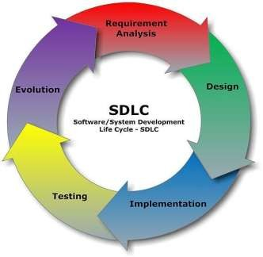
Project Report
Billing Software
4.1 Software development life-cycle(SDLC) :
The systems development life cycle (SDLC), or software development process in systems engineering, information systems and software engineering, is a process of creating or altering information systems, and the models and methodologies that people use to develop these systems. In software engineering, the SDLC concept underpins many kinds of software development methodologies. These methodologies form the framework for planning and controlling the creation of an information system: the software development process.
A Systems Development Life Cycle (SDLC) adheres to important phases that are essential for developers, such as planning, analysis, design, and implementation, and are explained in the section below.It include evaluation of present system, information gathering, feasibility study and request approval. A number of system development life cycle (SDLC) models have

Slide 16
Project Report Billing Software
been created: waterfall, fountain, spiral, build and fix, rapid prototyping, incremental, and synchronize and stabilize. The oldest of these, and the best known, is the waterfall model: a sequence of stages in which the output of each stage becomes the input for the next. These stages can be characterized and divided up in different ways, including the following:
Systems analysis, requirements definition: Defines project goals into defined functions and operation of the intended application. Analyzes end-user information needs.
Systems design: Describes desired features and operations in detail, including screen layouts, business rules, process diagrams, pseudocode and other documentation.
Development: The real code is written here.
Integration and testing: Brings all the pieces together into a special testing environment, then checks for errors, bugs and interoperability.
Acceptance, installation, deployment: The final stage of initial development, where the software is put into production and runs actual business.
Maintenance: What happens during the rest of the software's life: changes, correction, additions, moves to a different computing platform and more. This is often the longest of the stages.
5. DESIGN:
Design is the first step into the development phase for any engineered product or system. Design is a creative process. A good design is the key to effective system. The term “design” is defined as “the process of applying various techniques and principles for the purpose of

Slide 17
Project Report Billing Software
defining a process or a system in sufficient detail to permit its physical realization”. It may be defined as a process of applying various techniques and principles for the purpose of defining a device, a process or a system in sufficient detail to permit its physical realization. Software design sits at the technical kernel of the software engineering process and is applied regardless of the development paradigm that is used. The system design develops the architectural detail required to build a system or product. As in the case of any systematic approach, this software too has undergone the best possible design phase fine tuning all efficiency, performance and accuracy levels. The design phase is a transition from a user oriented document to a document to the programmers or database personnel. System design goes through two phases of development: Logical and Physical Design.
LOGICAL DESIGN:
The logical flow of a system and define the boundaries of a system. It includes the following steps:
Reviews the current physical system – its data flows, file content, volumes , Frequencies etc.
Prepares output specifications – that is, determines the format, content and Frequency of reports.
Prepares input specifications – format, content and most of the input functions.
Prepares edit, security and control specifications.
Specifies the implementation plan.
Prepares a logical design walk through of the information flow, output, input, Controls and implementation plan.
Reviews benefits, costs, target dates and system constraints.
PHYSICAL DESIGN:
Physical system produces the working systems by define the design specifications that tell the programmers exactly what the candidate system must do. It includes the following steps.

Slide 18
Project Report Billing Software
Design the physical system.
Specify input and output media.
Design the database and specify backup procedures.
Design physical information flow through the system and a physical design
Plan system implementation.
Prepare a conversion schedule and target date.
Determine training procedures, courses and timetable.
Devise a test and implementation plan and specify any new hardware/software.
Update benefits , costs , conversion date and system constraints
Design/Specification activities:
Concept formulation.
Problem understanding.
High level requirements proposals.
Feasibility study.
Requirements engineering.
Architectural design.
MODULE DESIGN
Admin institute
Employee of each branch
Admin of the institute:
Create update and delete accountanat details after login
Can search branchwise Employee
Can search all candidtates studying in various branches and can update and delete them

Slide 19
Project Report
Billing Software
Employee details:
Can search the student personal and payment details as per requirement after login
Can update the old student record
Can save new student informations
INPUT DESIGN:
The input design is the link between the information system and the user. It comprises the developing specification and procedures for data preparation and those steps are necessary to put transaction data in to a usable form for processing can be achieved by inspecting the computer to read data from a written or printed document or it can occur by having people keying the data directly into the system. The design of input focuses on controlling the amount of input required, controlling the errors, avoiding delay, avoiding extra steps and keeping the process simple. The input is designed in such a way so that it provides security and ease of use with retaining the privacy. Input Design considered the following things:
What data should be given as input?
How the data should be arranged or coded?
The dialog to guide the operating personnel in providing input.
Methods for preparing input validations and steps to follow when error occur.
OBJECTIVES:
Input Design is the process of converting a user-oriented description of the input into a computer-based system. This design is important to avoid errors in the data input process and show the correct direction to the management for getting correct information from the computerized system.
It is achieved by creating user-friendly screens for the data entry to handle large volume of data. The goal of designing input is to make data entry easier and to be

Slide 20
Project Report Billing Software
free from errors. The data entry screen is designed in such a way that all the data manipulates can be performed. It also provides record viewing facilities.
When the data is entered it will check for its validity. Data can be entered with the help of screens. Appropriate messages are provided as when needed so that the user will not be in maize of instant. Thus the objective of input design is to create an input layout that is easy to follow
OUTPUT DESIGN :
A quality output is one, which meets the requirements of the end user and presents the information clearly. In any system results of processing are communicated to the users and to other system through outputs. In output design it is determined how the information is to be displaced for immediate need and also the hard copy output. It is the most important and direct source information to the user. Efficient and intelligent output design improves the system’s relationship to help user decision-making.
Designing computer output should proceed in an organized, well thought out manner; the right output must be developed while ensuring that each output element is designed so that people will find the system can use easily and effectively. When analysis design computer output, they should Identify the specific output that is needed to meet the requirements.
Select methods for presenting information.
Create document, report, or other formats that contain information produced by the system.
The output form of an information system should accomplish one or more of the following objectives.
Convey information about past activities, current status or projections of the Future.
Signal important events, opportunities, problems, or warnings.

Slide 21
Project Report
Billing Software
Trigger an action.
Confirm an action.
5.6 Data Flow Diagram:
A data flow diagram (DFD) is a graphical representation of the "flow" of data through an information system, modeling its process aspects. Often they are a preliminary step used to create an overview of the system which can later be elaborated. DFDs can also be used for the visualization of data processing (structured design).
A DFD shows what kinds of information will be input to and output from the system, where the data will come from and go to, and where the data will be stored. It does not show
information about the timing of processes, or information about whether processes will operate in sequence or in parallel (which is shown on a flowchart).the basic notation used to create a DFD’s are as follows:
1. Dataflow: data moves in a specific from an origin to a destination.
2. Process: People ,procedures or device that use or produce data. The physical components not identified.
3. Source: external sorce or destination of data, which may be people programs, organizations or other entities.
4 .Data source: here data are store and referenced by a process in the system.

Slide 22
Project Report
Billing Software
0-LEVEL DFD
For The Admin:
UserID,
Detail
Admin
Payment billing
Accountant
Add
For the Employee :
UserID,
Detail
Employee
Billing Software
Customer
Add ,modify
Level 1 DFD- Administrator

Slide 23
Project Report
Billing Software
Administrator
Registration
User name,
View user
Login
Billing Software
View
salary
Add
Feedback
Level 1 DFD- Employee :
Use r
Registration
Registration
Username/Password
Username/Password
Login
Login
Verify
modify
Modify details
modified

Slide 24
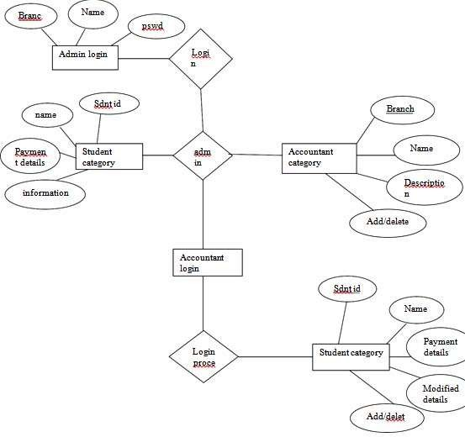
Project Report
Billing Software
E- R DIGRAM:
23

Slide 25
Project Report Billing Software
DATABASE DESIGN
A database is an organized mechanism that has the capability of storing information through which a user can retrieve stored information in an effective and efficient manner. The data is the purpose of any database and must be protected.
The database design is a two level process. In the first step, user requirements are gathered together and a database is designed which will meet these requirements as clearly as possible. This step is called Information Level Design and it is taken independent of any individual DBMS.
In the second step, this Information level design is transferred into a design for the specific DBMS that will be used to implement the system in question. This step is called Physical Level Design, concerned with the characteristics of the specific DBMS that will be used. A database design runs parallel with the system design. The organization of the data in the database is aimed to achieve the following two major objectives.
Data Integrity
Data independence
Normalization is the process of decomposing the attributes in an application, which
results in a set of tables with very simple structure. The purpose of normalization is to make tables as simple as possible. Normalization is carried out in this system for the following
reasons.
To structure the data so that there is no repetition of data , this helps in saving.
To permit simple retrieval of data in response to query and report request.
To simplify the maintenance of the data through updates, insertions, Deletions.
To reduce the need to restructure or reorganize data which new application Requirements arise.
25

Slide 26
Project Report Billing Software
FEATURES OF O.S :
This project work is done on the windows 2000 professional, which is the operating system. An operating system is a set of software tools designed to make it easy for people or programmers to make optimum use of the computer. People who use computers have different levels of needs and interest. These peoples can be separated can be two groups, users and programmers. The user wants a convenient set of commands to manage files of data or programs, copy and run application package while a programmer used as a set of tools that can be held together and debug programs.
No matter where you are working, your computer will be easier to use and manage, because Microsoft Windows 2000 Professional is more compatible and more powerful than any workstation you’ve used before. The main features of Windows 2000 Professional operating system are
Easier to use.
Easier to manage
More compatible
More powerful
EASIER TO USE
With Windows 2000 Professional, you have faster access to information, and you arte able to accomplish tasks more quickly and easily.
Windows 2000 Professional makes it easier to:
Work with files.
Find information.
Personalize your computing environment.
Work on the web.
Work remotely
EASIER TO MANAGE
You and your network administrators can work more efficiently now, because many of the most common computer-management tasks are automated are streamlined with Windows 2000 Professional.
With Windows 2000, your workstation will be easier to:
26

Slide 27
Project Report
Billing Software
Set up.
Administrator
Support.
MORE COMPATIBLE:
Windows 2000 Professional offers increased compatibility with different types of network and with a wide array of legacy hardware and software.
Windows 2000 also provides:
Improved driver support.
Increased support for new-generation hardware multimedia technologies.
MORE POWERFUL:
For all your computing needs, Windows 2000 Professional provides:
Industrial-strength reliability
The highest level of security
Powerful performance
Windows 2000 also contains the following features:
PORTABILITY:
Windows file protection protects core system files from being overwritten by application installs.
Driver certification provides safeguards to assure you that device drivers have not been tampered with and reduces your risk of installing non-certified drivers.
Full 32 bit operating system minimizes the chance of application failures and
unplanned reboots.
27

Slide 28
Project Report
MOBILITY
Billing Software
Hibernate turns off your computer and monitors after a predetermined time while retaining your desktop on disk.
Offline viewing makes entire WebPages with graphics available for viewing offline
Synchronization manager allows you to compare and update your offline files and folders with those on the network.
Smart battery gives you a more accurate view of your battery’s life enabling you to reduce power to specify functions to extend your battery power.
Hot docking tells you dock or undock your notebook computer without changing
hardware configuration or rebooting.
Universal Serial Bus (USB) lets you connect and disconnect a wide array of peripherals such as joysticks, scanners and camcorders without configuring or rebooting your computer.
J2EE 1394 provides a higher band width connection for devices that require faster data transfer.
MAINTAINABILITY
System preparation tool (sys prep) helps administrators clone computer configuration systems and applications.
Set up manager provides a graphical wizard that guides administrators in designing installation scripts.
Multilingual support allows users to easily create, read and edit documentation in
hundreds of languages.
Windows 2000 server offers 25% faster performance than Windows 95 or Windows 98 on systems with 64MB or more of memory.
32 bit architecture allows you to run more programs and perform more faster at the same time than Windows 95 or 98.
Windows 2000 can support to 4GB of Ram and two symmetric multiprocessors.
Encrypting file system (EFS) encrypts each file with a randomly generated key.
IP Security (IP Sec) support protected data transmitted across a network.
Kerberos support provides industry standard high-strength authentication with a fast, single login to windows 2000 enterprise resources.
28

Slide 29
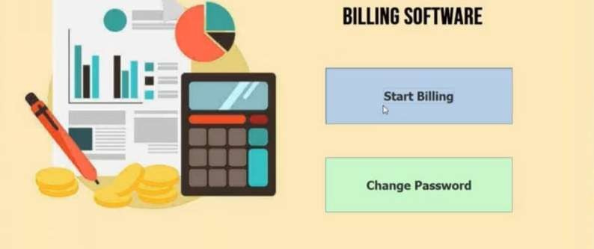
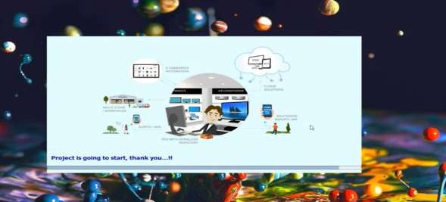
Project Report
INTERNET CAPABILITY
Billing Software
Internet Information Services (IIS) 5.0 includes web and FTP server support, aswell as support for Front-page transactions, Active Server Pages (ASP) and database connections.
Windows 2000 has strong development platform support for dynamic HTML behaviors and XML.
Intelliforms alleviates the tedious of filling out forms on the web by automatically
entering your name, address or other information that you have securely stored on your computer.
Automated proxy automatically locates a proxy server configures Internet Explorer
5.0 to connect to the internet through the server.
8. Screen Shots
29

Slide 30
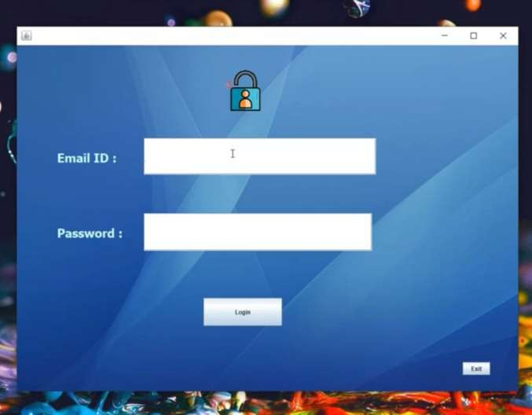
Project Report
Billing Software
30

Slide 31
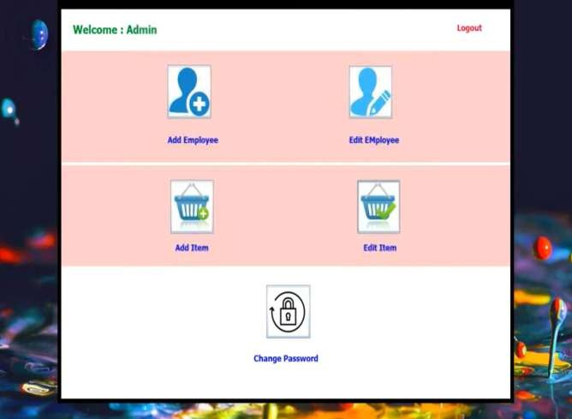
Project Report
Billing Software
31

Slide 32
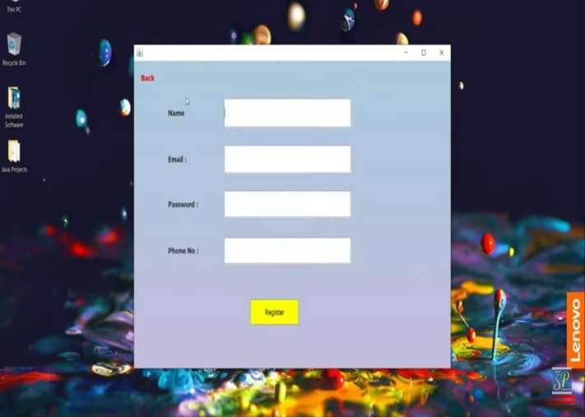
Project Report
Billing Software
32

Slide 33
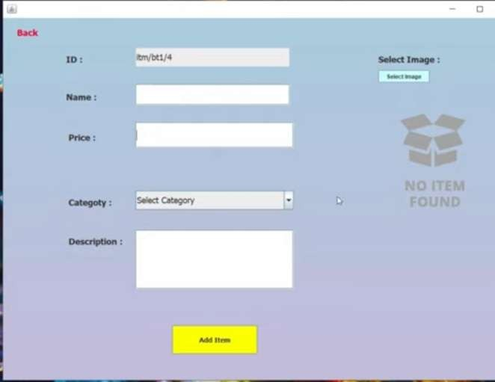
Project Report
Billing Software
33

Slide 34
Project Report
Billing Software
9. Testing :
Software Testing is the process of executing software in a controlled manner, in order to answer the question - Does the software behave as specified?. Software testing is often used in association with the terms verification and validation. Validation is the checking or testing of items, includes software, for conformance and consistency with an associated specification. Software testing is just one kind of verification, which also uses techniques such as reviews, analysis, inspections, and walkthroughs. Validation is the process of checking that what has been specified is what the user actually wanted.
Validation Verification
: Are we doing the right job?
: Are we doing the job right?
Software testing should not be confused with debugging. Debugging is the process of analyzing and localizing bugs when software does not behave as expected. Although the identification of some bugs will be obvious from playing with the software, a methodical approach to software testing is a much more thorough means for identifying bugs. Debugging is therefore an activity which supports testing, but cannot replace testing.
34

Slide 35
Project Report Billing Software
Other activities which are often associated with software testing are static analysis and dynamic analysis. Static analysis investigates the source code of software, looking for problems and gathering metrics without actually executing the code. Dynamic analysis looks at the behavior of software while it is executing, to provide information such as execution traces, timing profiles, and test coverage information.
Testing is a set of activity that can be planned in advanced and conducted systematically. Testing begins at the module level and work towards the integration of entire computers based system. Nothing is complete without testing, as it vital success of the system testing objectives, there are several rules that can serve as testing objectives. They are
Testing is a process of executing a program with the intend of findingan error.
A good test case is one that has high possibility of finding an undiscovered error.
A successful test is one that uncovers an undiscovered error.
If a testing is conducted successfully according to the objectives as stated above, it would uncovered errors in the software also testing demonstrate that the software function appear to be working according to the specification, that performance requirement appear to have been met.
There are three ways to test program.
For correctness
For implementation efficiency
For computational complexity
Test for correctness are supposed to verify that a program does exactly what it was designed to do. This is much more difficult than it may at first appear, especially for large programs.
9.1 TEST PLAN
A test plan implies a series of desired course of action to be followed in accomplishing
various testing methods. The Test Plan acts as a blue print for the action that is to be followed. The software engineers create a computer program, its documentation and related data structures. The software developers is always responsible for testing the individual units of the programs, ensuring that each performs the function for which it was designed. There is an independent test group (ITG) which is to remove the inherent problems associated with
35

Slide 36
Project Report Billing Software
letting the builder to test the thing that has been built. The specific objectives of testing should be stated in measurable terms. So that the mean time to failure, the cost to find and fix the defects, remaining defect density or frequency of occurrence and test work-hours per regression test all should be stated within the test plan.
The levels of testing include:
Unit testing
Integration Testing
Data validation Testing
Output Testing
9.1.1 UNIT TESTING
Unit testing focuses verification effort on the smallest unit of software design – the software component or module. Using the component level design description as a guide, important control paths are tested to uncover errors within the boundary of the module. The relative complexity of tests and uncovered scope established for unit testing. The unit testing is white-box oriented, and step can be conducted in parallel for multiple components. The modular interface is tested to ensure that information properly flows into and out of the program unit under test. The local data structure is examined to ensure that data stored temporarily maintains its integrity during all steps in an algorithm’s execution. Boundary conditions are tested to ensure that all statements in a module have been executed at least once. Finally, all error handling paths are tested.
Tests of data flow across a module interface are required before any other test is initiated. If data do not enter and exit properly, all other tests are moot. Selective testing of execution paths is an essential task during the unit test. Good design dictates that error conditions be anticipated and error handling paths set up to reroute or cleanly terminate processing when an error does occur. Boundary testing is the last task of unit testing step. Software often fails at its boundaries.
36

Slide 37
Project Report
Billing Software
10. Conclusion :
The project titled as “Billing Software” is a web based application. This software provides facility for, create ,update and delete Employees details after login . it can search branch wise Employee. And also search all candidates studying in the various branchesand can update and delete them The software is developed with modular approach. All modules in the system have been tested with valid data and invalid data and everything work successfully. Thus the system has fulfilled all the objectives identified and is able to replace the existing system.
The project has been completed successfully with the maximum satisfaction of the organization. The constraints are met and overcome successfully. The system is designed as like it was decided in the design phase. The project gives good idea on developing a full- fledged application satisfying the user requirements.
The system is very flexible and versatile. This software has a user-friendly screen that enables the user to use without any inconvenience. Validation checks induced have greatly reduced errors. Provisions have been made to upgrade the software.
37

Slide 38
Project Report
Billing Software
Limitations
It is not cost-effective for small scale business owners.
Invoices can go into spam folders due to flagging by email servers; that leads to delay of payments.
Reaching offline customers who do not access the internet makes the process difficult.
Automatic invoices and management system reduces human mediation, which reduces
personal touch for the business.
Scope for Future Enhancement:
In future we can use photo reorganization instead of using heterogeneous database more over High speed, accuracy and non-redundant data are the main advantages of the proposed system. In the proposed system the user is provided with a choice of data screen, which are similar in formats to the source documents. Data entry errors can be minimized through validity checks. After the verification only the data are placed the permanent database. The software can be developed further to include a lot of modules because the proposed system is developed on the view of future, for example we should develop the system as a database independent using JDBC so we can connect it to any other database, Now the proposed system is based on PC and intranet but in the future if we need to convert it into internet then we need to change the front end only because we are developing this on the basis of OOP technology and most of the business logic’s are bounded in the class files and module like reusable components.
38

Slide 39
Project Report
Billing Software
ONLINE REFERENCE:
www.java.sun.com
www.w3schools.com
www.wikipedia.com
39

